Slide 1
Stack and Queue
COMP171
Fall 2005

Slide 2
Stack Overview
Stack ADT
Basic operations of stack
  Pushing, popping etc.
Implementations of stacks using
  array
  linked list

Slide 3
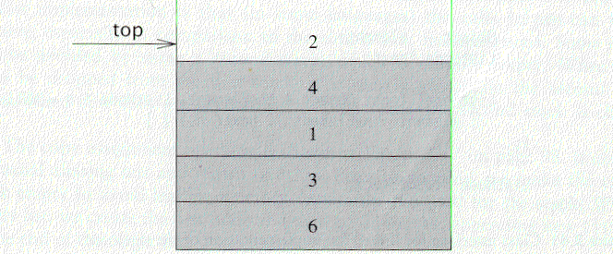
The Stack ADT
A stack is a list with the restriction
  that insertions and deletions can only be performed at the top of the list
  The other end is called bottom
Fundamental operations:
  Push: Equivalent to an insert
  Pop: Deletes the most recently inserted element
  Top: Examines the most recently inserted element

Slide 4
Stack ADT
Stacks are less flexible
  but are more efficient and easy to implement
Stacks are known as LIFO (Last In, First Out) lists.
  The last element inserted will be the first to be retrieved

Slide 5
Push and Pop
Primary operations: Push and Pop
Push
  Add an element to the top of the stack
Pop
  Remove the element at the top of the stack
empty stack
push an element
push another
pop
top
B
top
top
top
A
A
A

Slide 6
Implementation of Stacks
Any list implementation could be used to implement a stack
  Arrays (static: the size of stack is given initially)
  Linked lists (dynamic: never become full)
We will explore implementations based on array and linked list
Let’s see how to use an array to implement a stack first

Slide 7
Array Implementation
Need to declare an array size ahead of time
Associated with each stack is TopOfStack
  for an empty stack, set TopOfStack to -1
Push
  (1) Increment TopOfStack by 1.
  (2) Set Stack[TopOfStack] = X
Pop
  (1) Set return value to Stack[TopOfStack]
  (2) Decrement TopOfStack by 1
These operations are performed in very fast constant time

Slide 8
Stack class
class Stack {
public:
Stack(int size = 10); // constructor
~Stack() { delete [] values; } // destructor
bool IsEmpty() { return top == -1; }
bool IsFull() { return top == maxTop; }
double Top();
void Push(const double x);
double Pop();
void DisplayStack();
private:
int maxTop; // max stack size = size - 1
int top; // current top of stack
double* values; // element array
};

Slide 9
Stack class
Attributes of Stack
  maxTop: the max size of stack
  top: the index of the top element of stack
  values: point to an array which stores elements of stack
Operations of Stack
  IsEmpty: return true if stack is empty, return false otherwise
  IsFull: return true if stack is full, return false otherwise
  Top: return the element at the top of stack
  Push: add an element to the top of stack
  Pop: delete the element at the top of stack
  DisplayStack: print all the data in the stack

Slide 10
Create Stack
The constructor of Stack
  Allocate a stack array of size. By default,
  size = 10.
  When the stack is full, top will have its maximum value, i.e. size – 1.
  Initially top is set to -1. It means the stack is empty.
Stack::Stack(int size /*= 10*/) {
maxTop = size - 1;
values = new double[size];
top = -1;
}
Although the constructor dynamically allocates the stack array, the stack is still static. The size is fixed after the initialization.

Slide 11
Push Stack
void Push(const double x);
  Push an element onto the stack
  If the stack is full, print the error information.
  Note top always represents the index of the top element. After pushing an element, increment top.
void Stack::Push(const double x) {
if (IsFull())
cout << "Error: the stack is full." << endl;
else
values[++top] = x;
}

Slide 12
Pop Stack
double Pop()
  Pop and return the element at the top of the stack
  If the stack is empty, print the error information. (In this case, the return value is useless.)
  Don’t forgot to decrement top
double Stack::Pop() {
if (IsEmpty()) {
cout << "Error: the stack is empty." << endl;
return -1;
}
else {
return values[top--];
}
}

Slide 13
Stack Top
double Top()
  Return the top element of the stack
  Unlike Pop, this function does not remove the top element
double Stack::Top() {
if (IsEmpty()) {
cout << "Error: the stack is empty." << endl;
return -1;
}
else
return values[top];
}

Slide 14

Printing all the elements
void DisplayStack()
  Print all the elements
void Stack::DisplayStack() {
cout << "top -->";
for (int i = top; i >= 0; i--)
cout << "\t|\t" << values[i] << "\t|" << endl;
cout << "\t|---------------|" << endl;
}

Slide 15
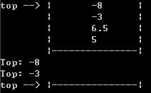
Using Stack
result
int main(void) {
Stack stack(5);
stack.Push(5.0);
stack.Push(6.5);
stack.Push(-3.0);
stack.Push(-8.0);
stack.DisplayStack();
cout << "Top: " << stack.Top() << endl;
stack.Pop();
cout << "Top: " << stack.Top() << endl;
while (!stack.IsEmpty()) stack.Pop();
stack.DisplayStack();
return 0;
}

Slide 16
Implementation based on Linked List
A stack data structure can be implemented by using a linked list data structure. The stack implemented using a linked list can work for a large number of values. That means, stack implemented using the linked list works for the variable size of data. So, there is no need to fix the size at the beginning of the implementation.

Slide 17
Implementation based on Linked List
Now let us implement a stack based on a linked list
To make the best out of the code of List, we implement Stack by inheriting List
  To let Stack access private member head, we make Stack as a friend of List
class List {
public:
List(void) { head = NULL; } // constructor
~List(void); // destructor
bool IsEmpty() { return head == NULL; }
Node* InsertNode(int index, double x);
int FindNode(double x);
int DeleteNode(double x);
void DisplayList(void);
private:
Node* head;
friend class Stack;
};

Slide 18
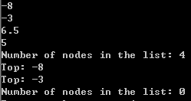
Implementation based on Linked List
class Stack : public List {
public:
Stack() {} // constructor
~Stack() {} // destructor
double Top() {
if (head == NULL) {
cout << "Error: the stack is empty." << endl;
return -1;
}
else
return head->data;
}
void Push(const double x) { InsertNode(0, x); }
double Pop() {
if (head == NULL) {
cout << "Error: the stack is empty." << endl;
return -1;
}
else {
double val = head->data;
DeleteNode(val);
return val;
}
}
void DisplayStack() { DisplayList(); }
};
Note: the stack implementation based on a linked list will never be full.

Slide 19
Balancing Symbols
To check that every right brace, bracket, and parentheses must correspond to its left counterpart
  e.g. [( )] is legal, but [( ] ) is illegal
Algorithm
  (1) Make an empty stack.
  (2) Read characters until end of file
    i. If the character is an opening symbol, push it onto the stack
    ii. If it is a closing symbol, then if the stack is empty, report an error
    iii. Otherwise, pop the stack. If the symbol popped is not the
    corresponding opening symbol, then report an error
  (3) At end of file, if the stack is not empty, report an error

Slide 20
Postfix Expressions
Calculate 4.99 * 1.06 + 5.99 + 6.99 * 1.06
  Need to know the precedence rules
Postfix (reverse Polish) expression
  4.99 1.06 * 5.99 + 6.99 1.06 * +
Use stack to evaluate postfix expressions
  When a number is seen, it is pushed onto the stack
  When an operator is seen, the operator is applied to the 2 numbers that are popped from the stack. The result is pushed onto the stack
Example
  evaluate 6 5 2 3 + 8 * + 3 + *
The time to evaluate a postfix expression is O(N)
  processing each element in the input consists of stack operations and thus takes constant time

Slide 21
